Slide 1
ME16A: CHAPTER FOUR
ANALYSIS OF STRESSES IN TWO DIMENSIONS

Slide 2
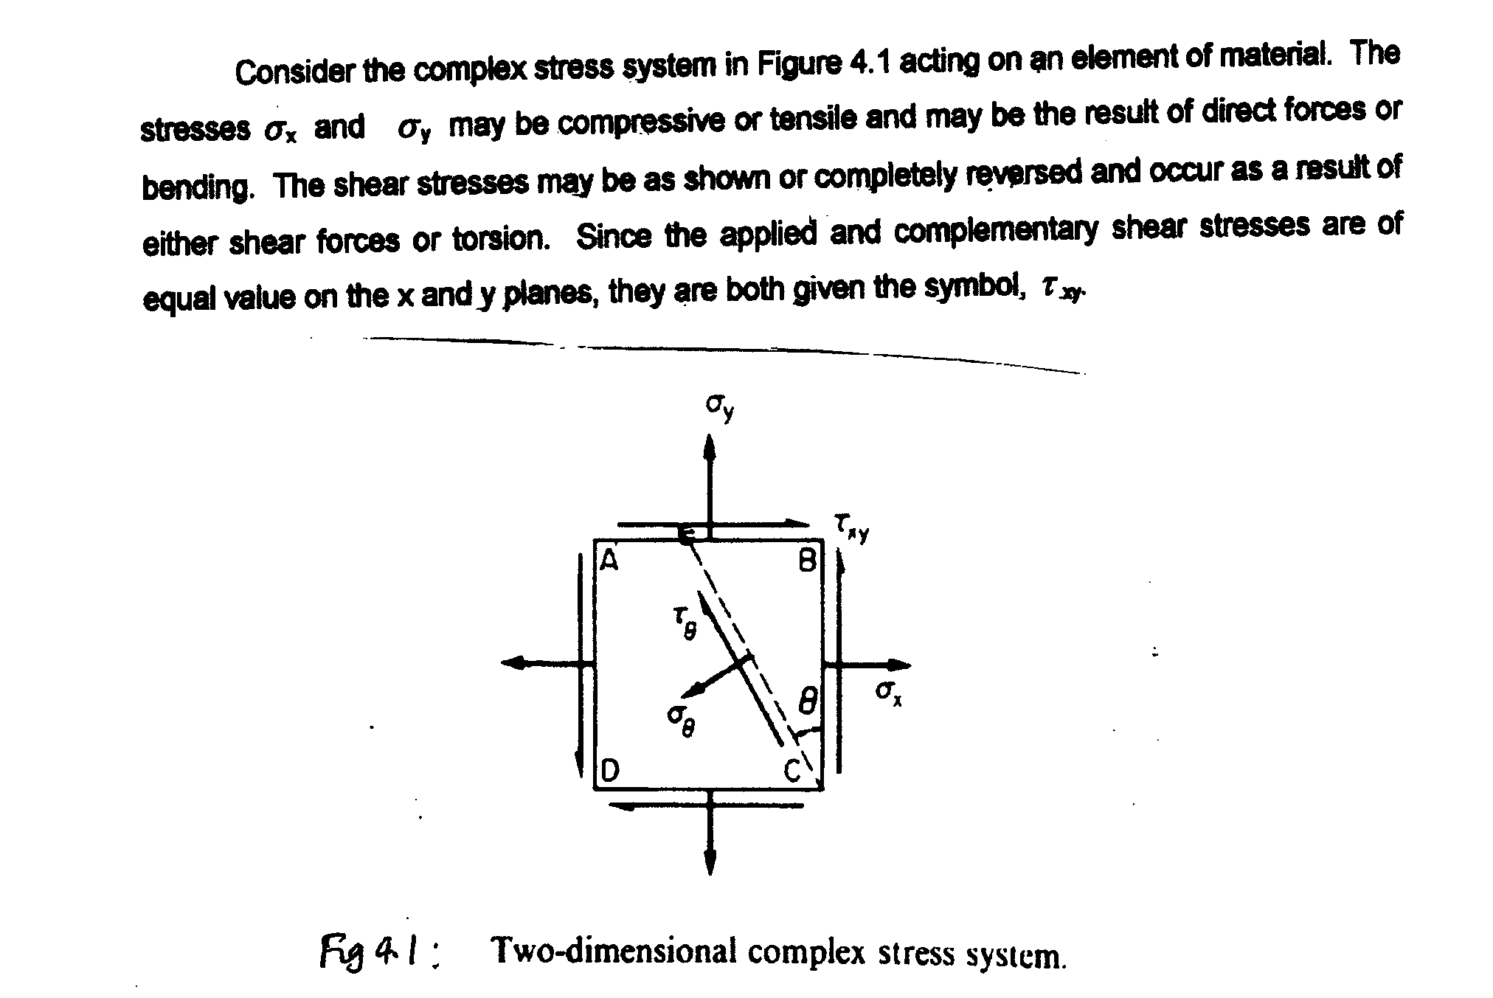
4.1 DERIVATION OF GENERAL EQUATIONS

Slide 3
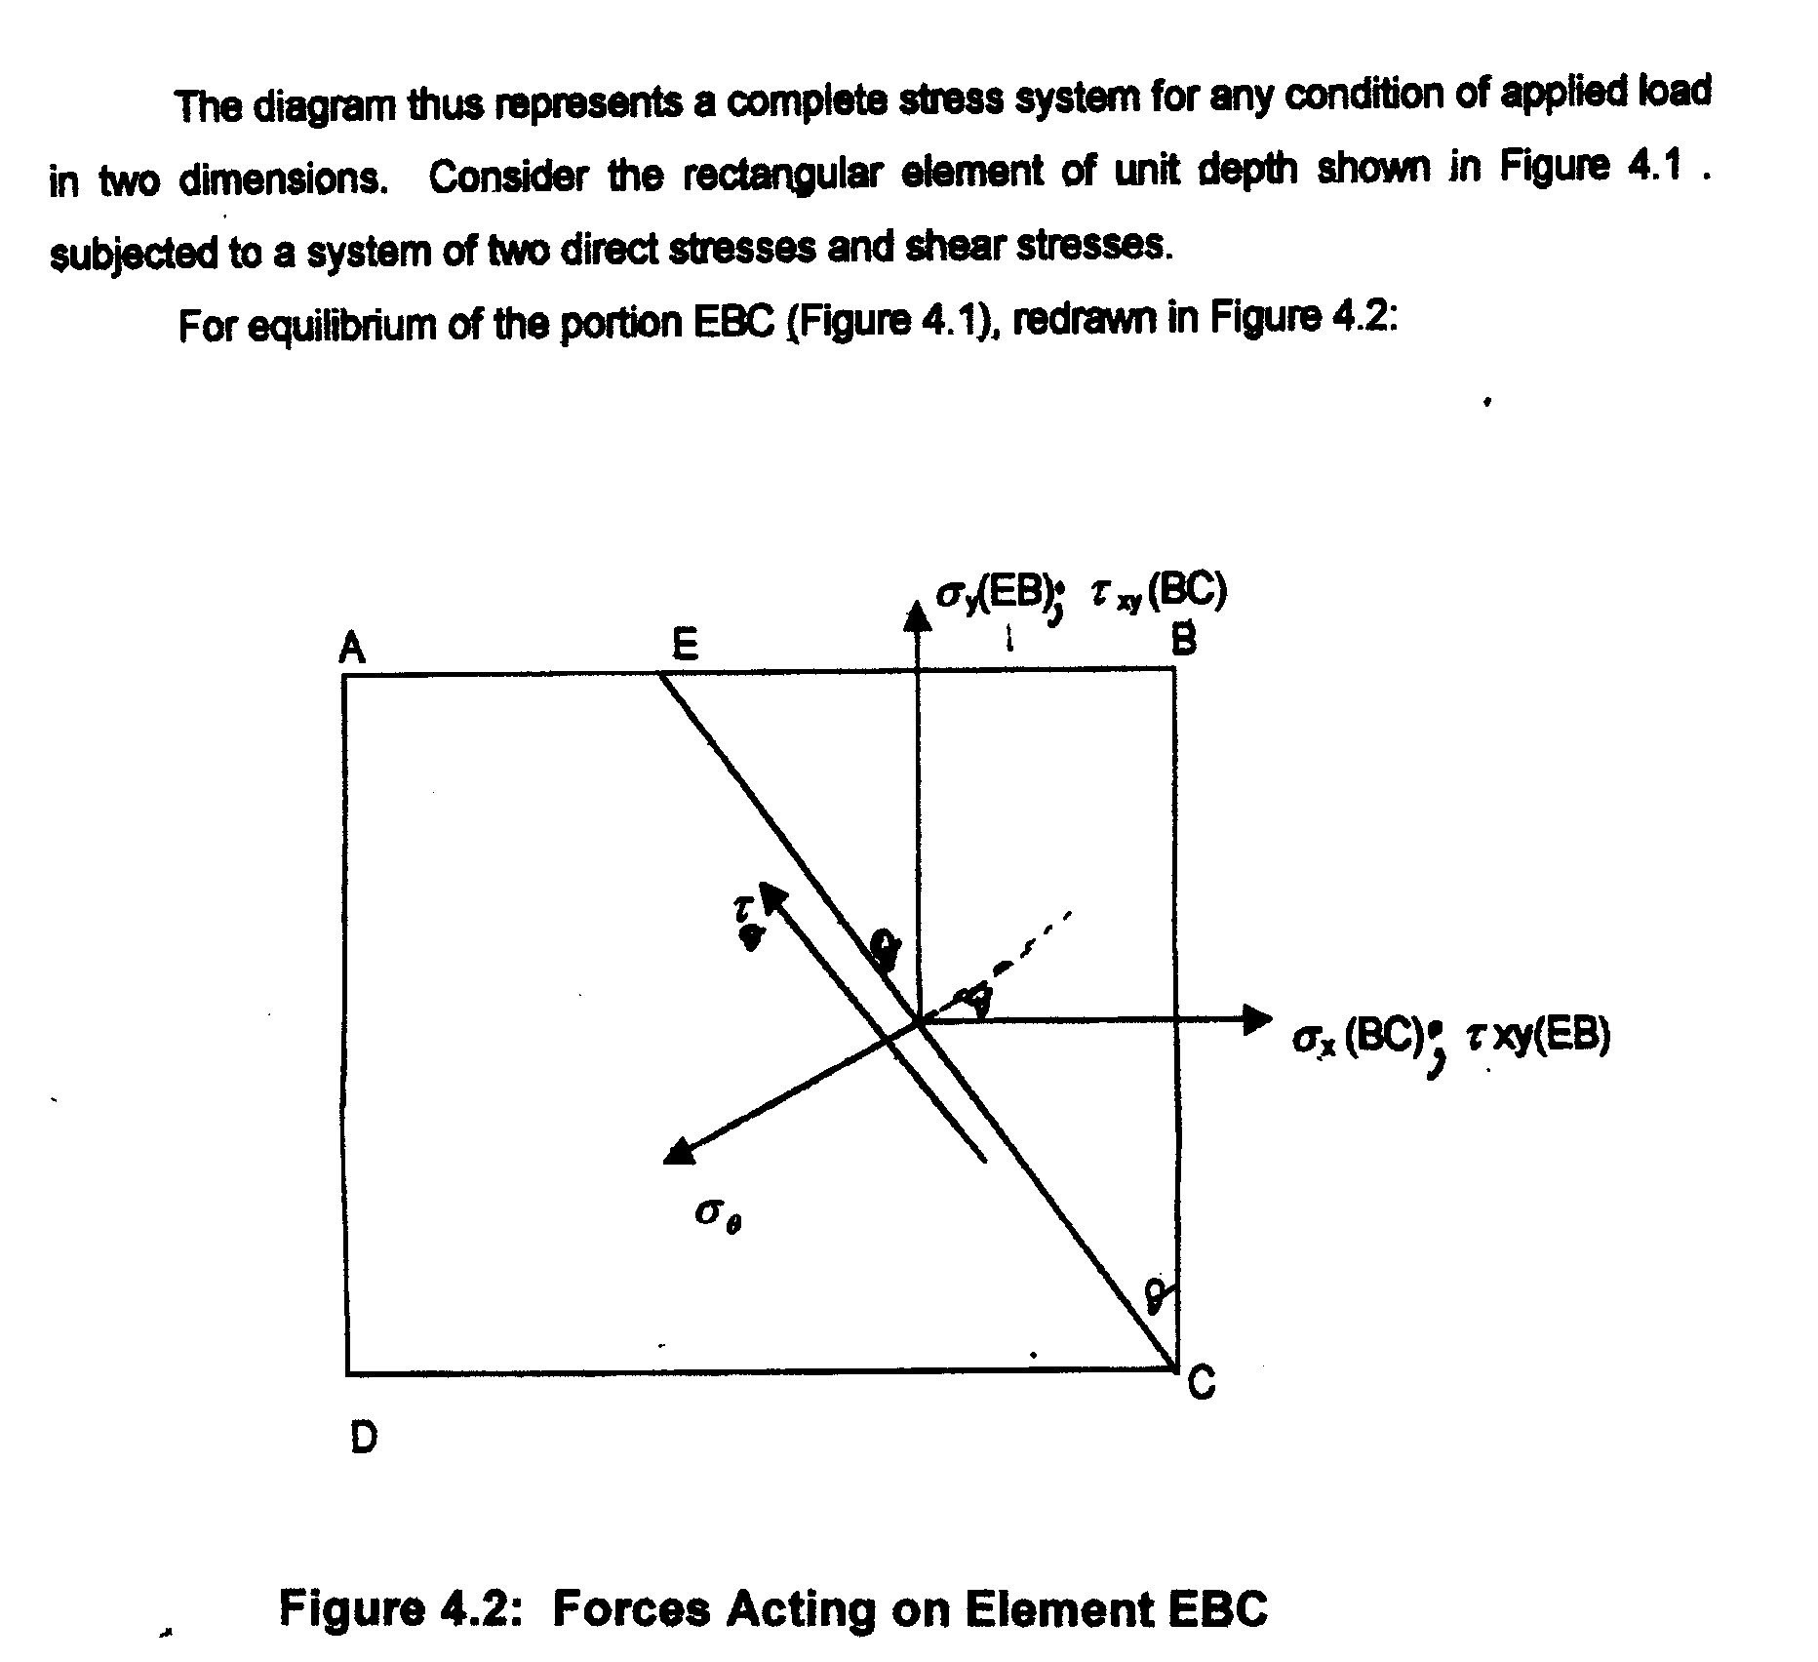

Slide 4
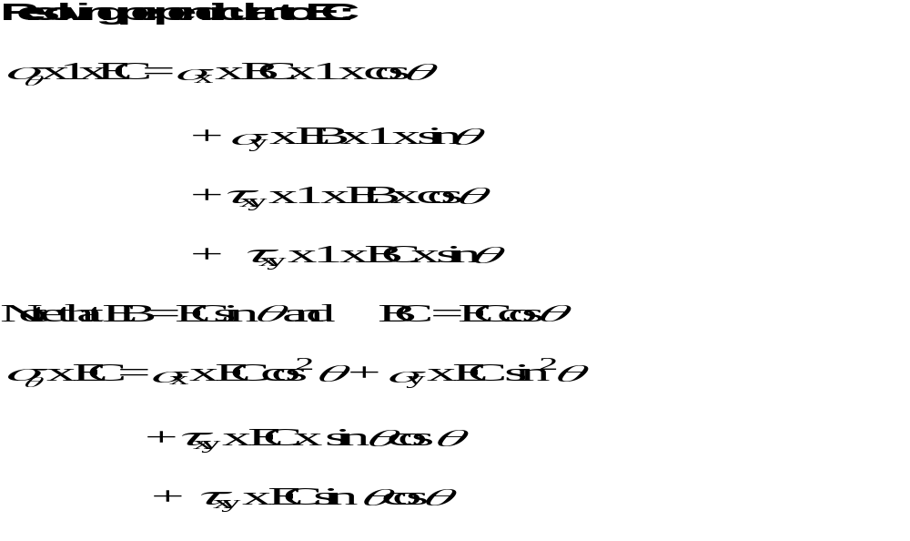
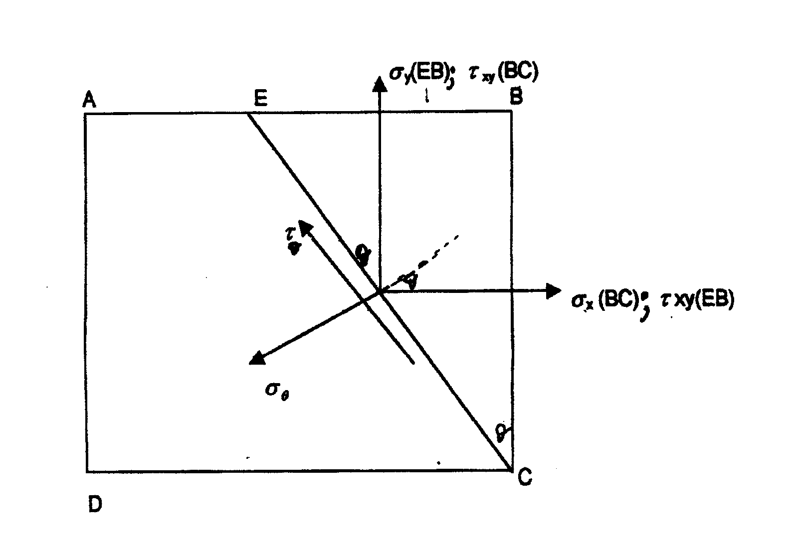

Slide 5
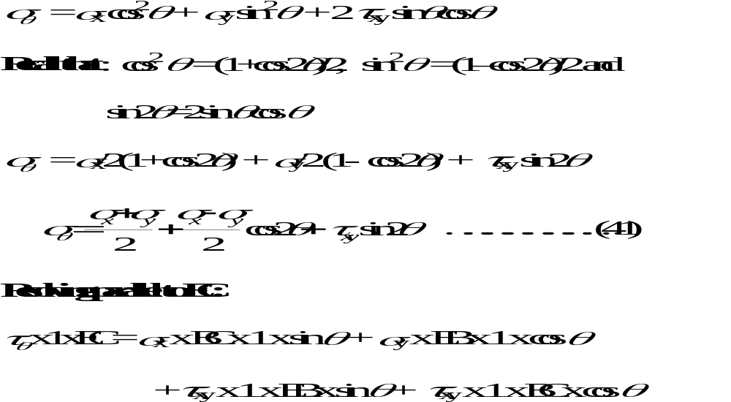

Slide 6
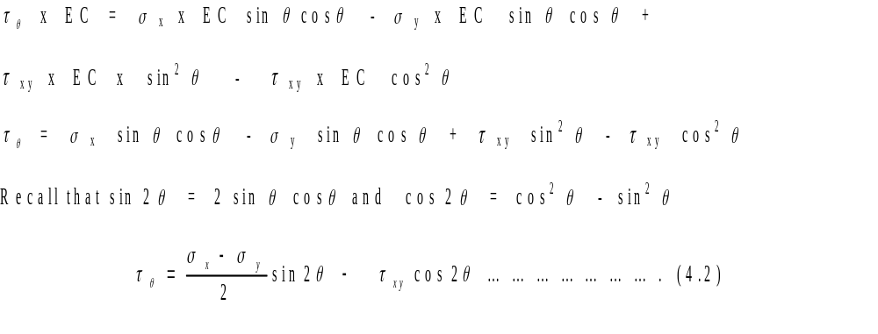
Derivation of General Equation Concluded

Slide 7
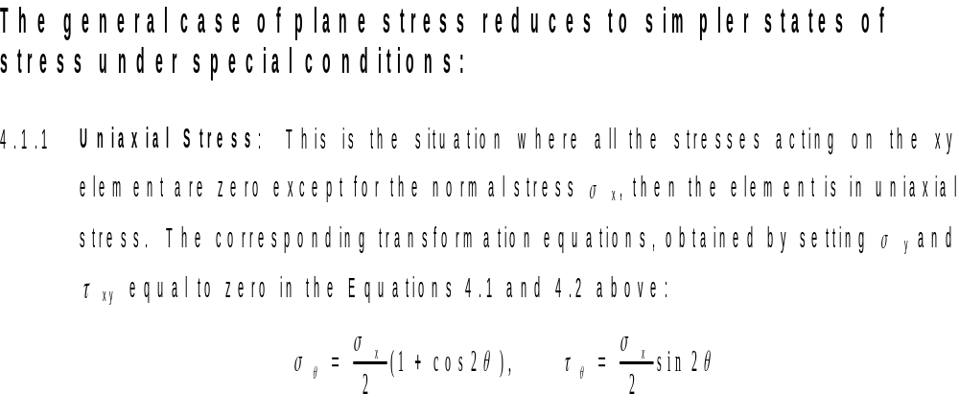
SPECIAL CASES OF PLANE STRESS

Slide 8
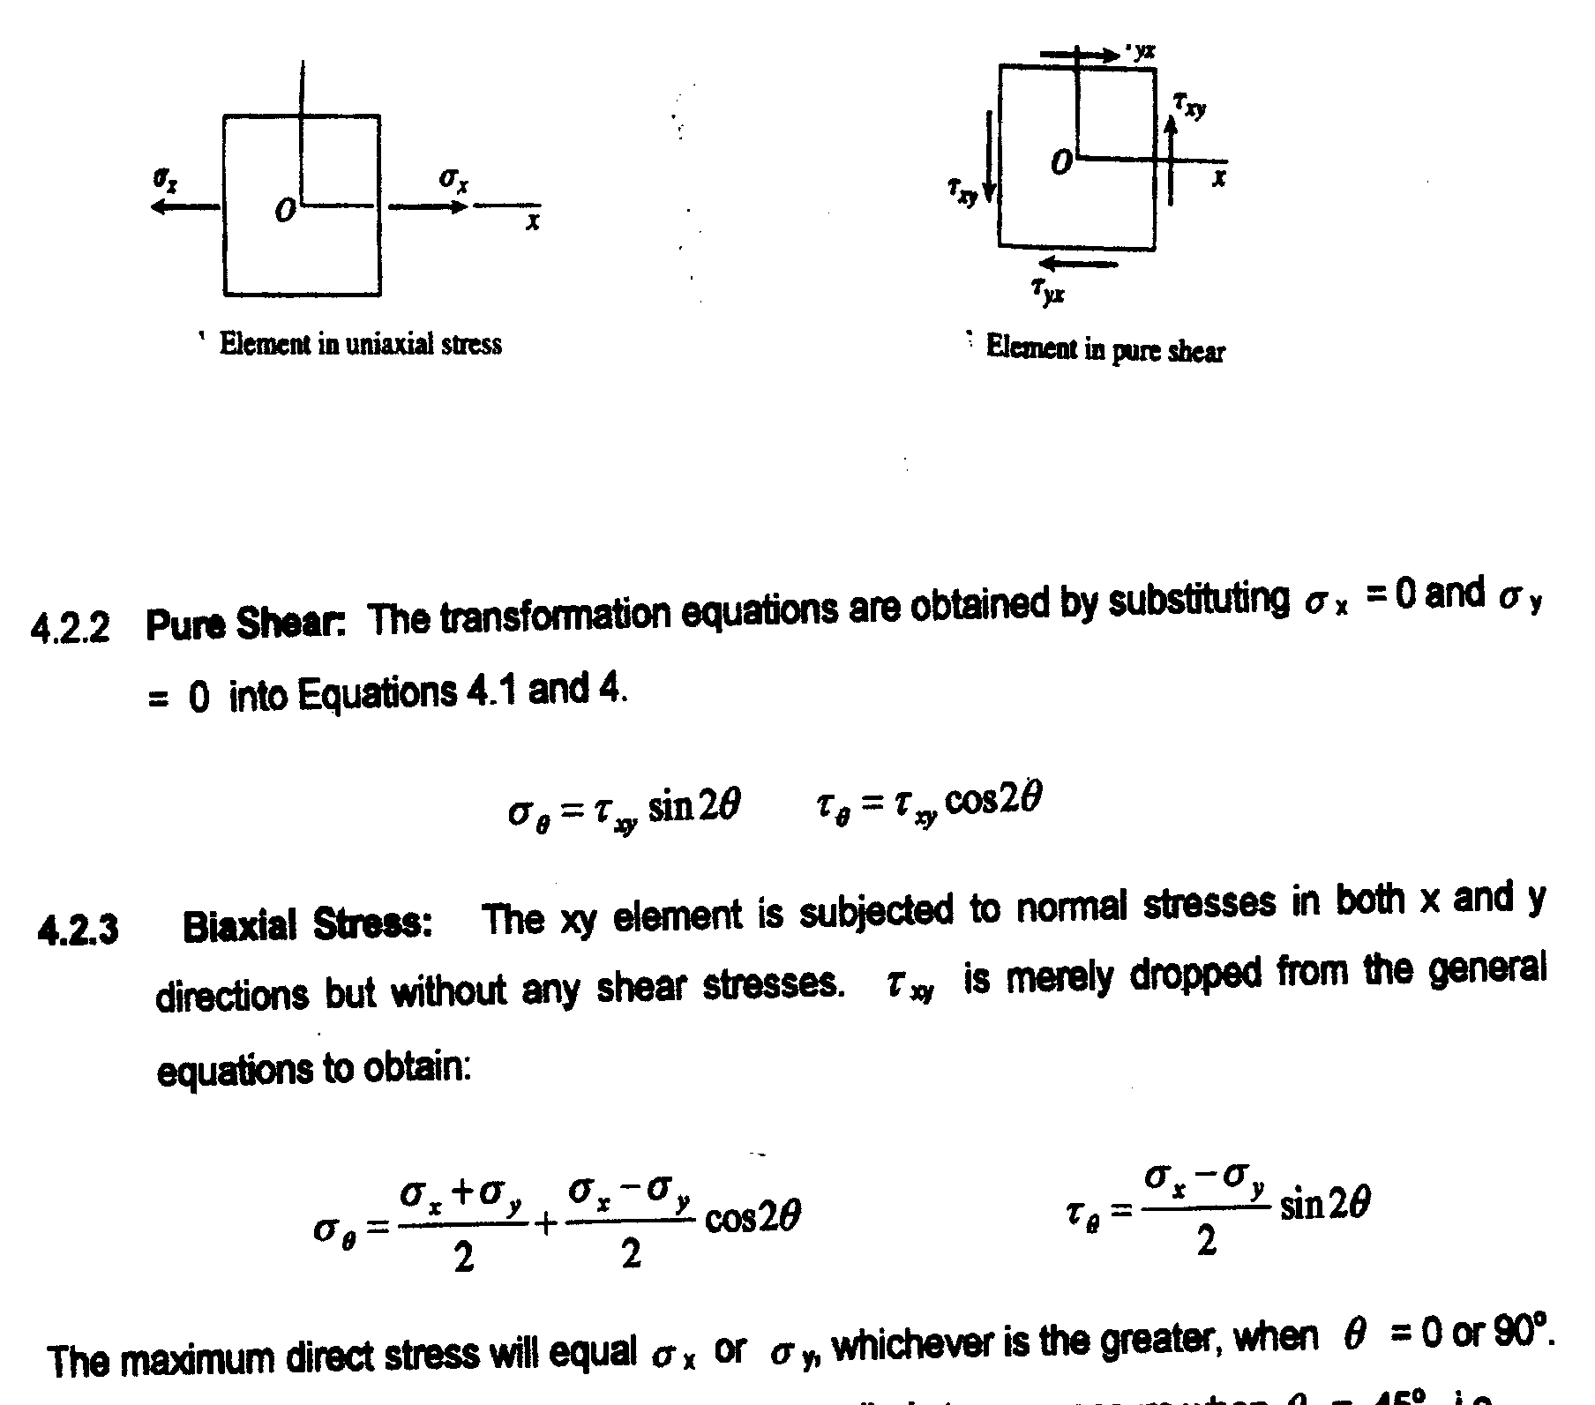
Special Cases of Plane Stress Contd.

Slide 9
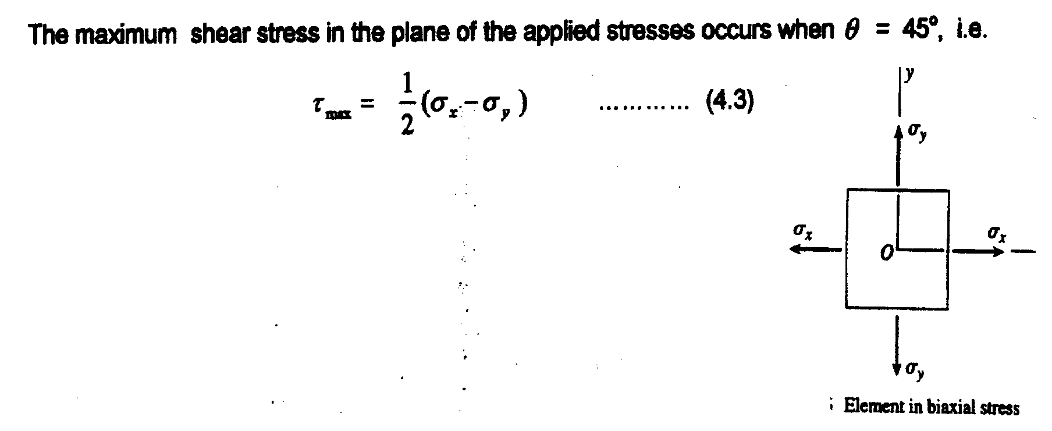
Maximum Shear Stress

Slide 10
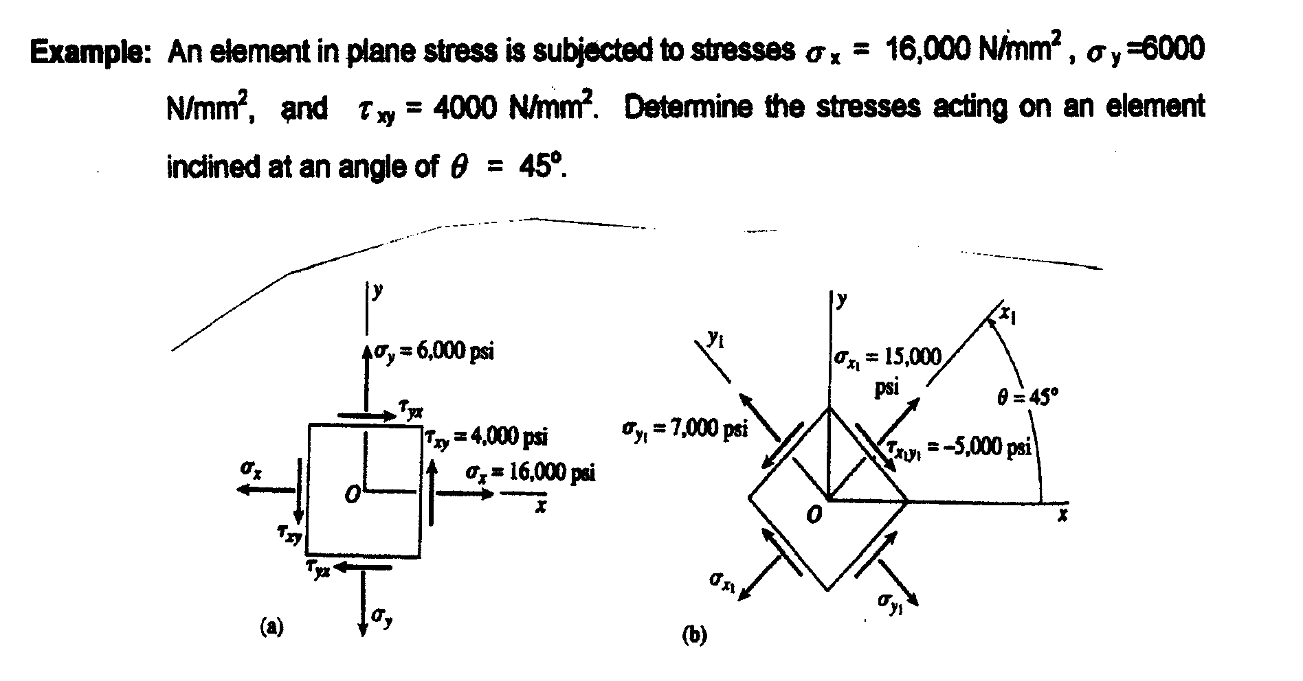
Example

Slide 11
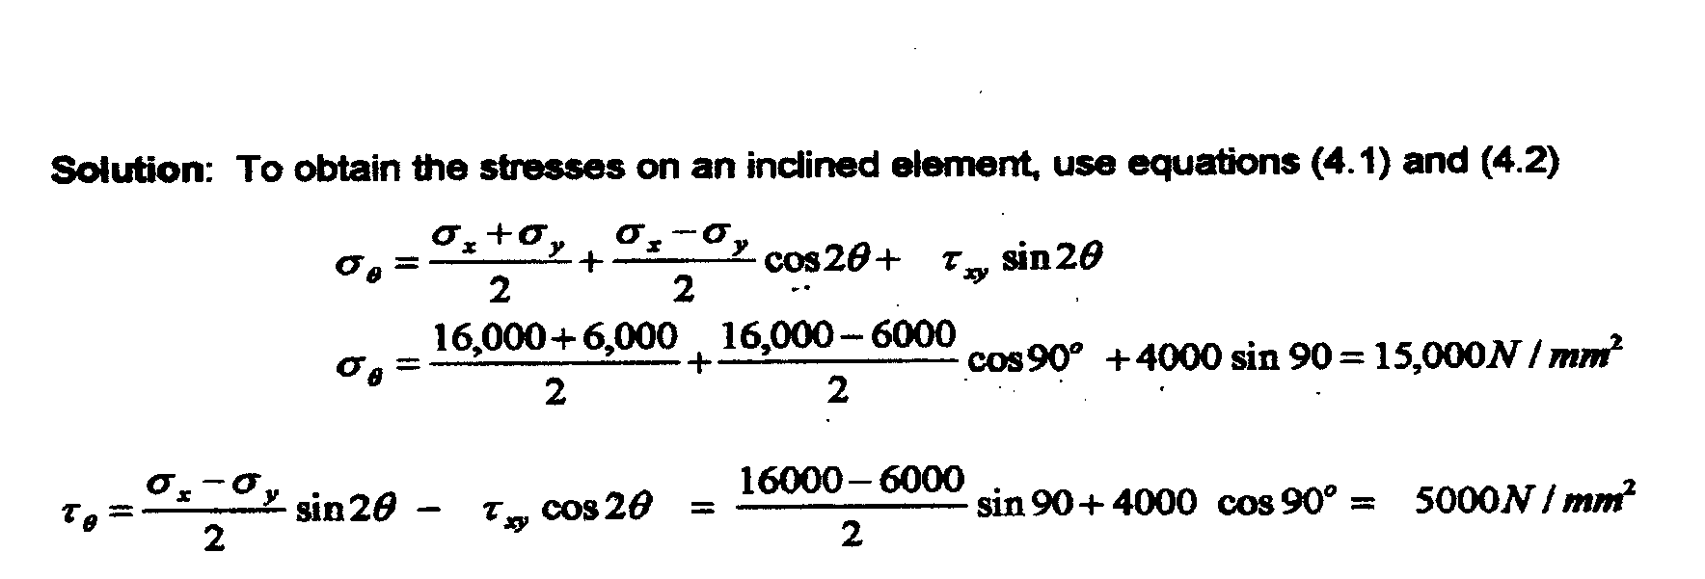
Solution

Slide 12
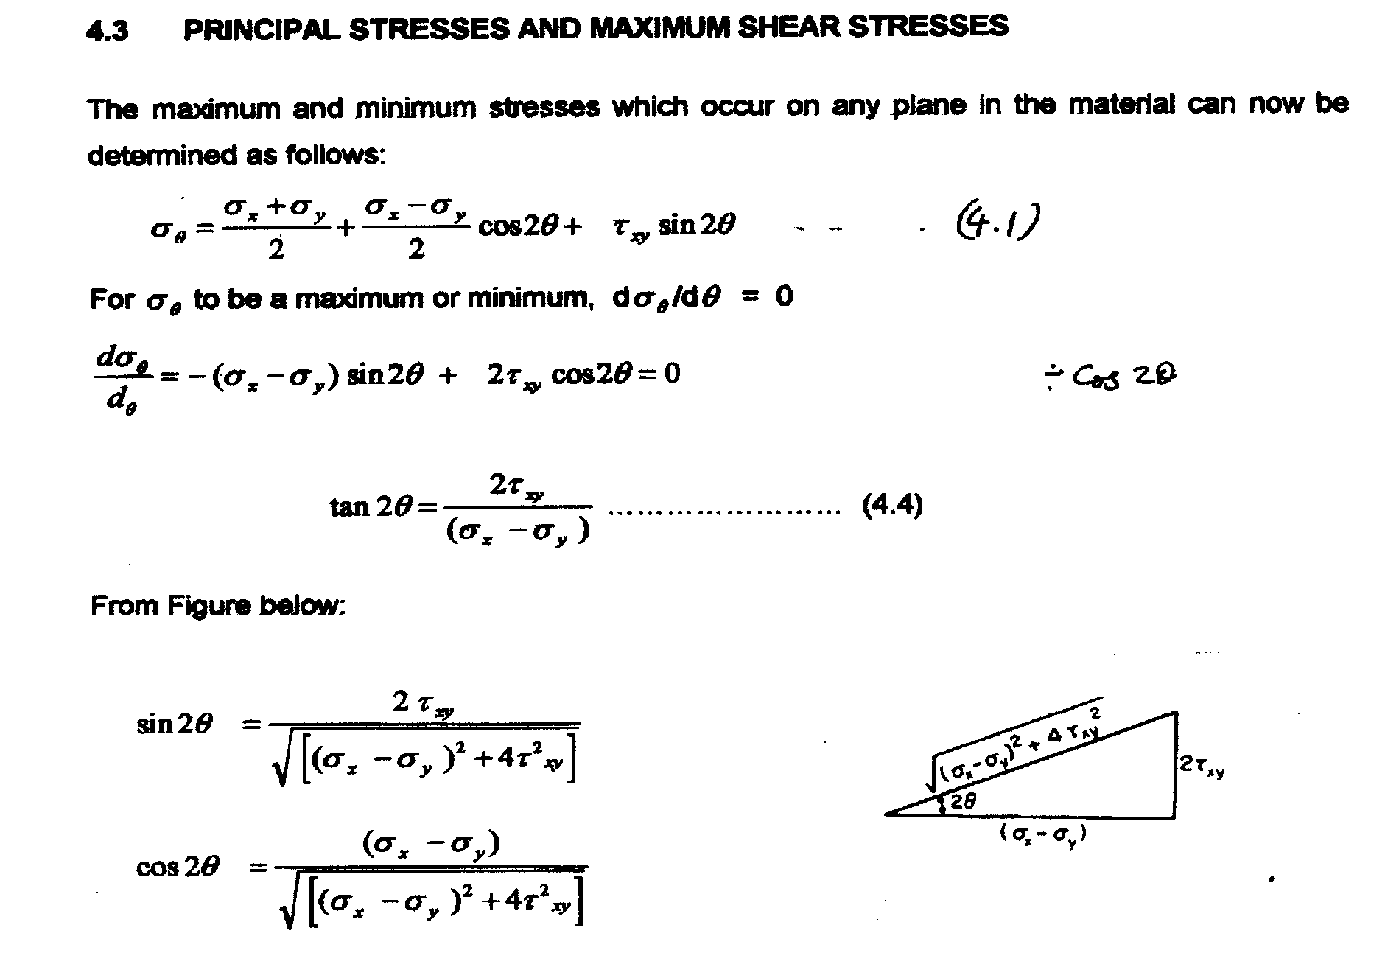
Principal Stresses and Maximum Shear Stresses

Slide 13
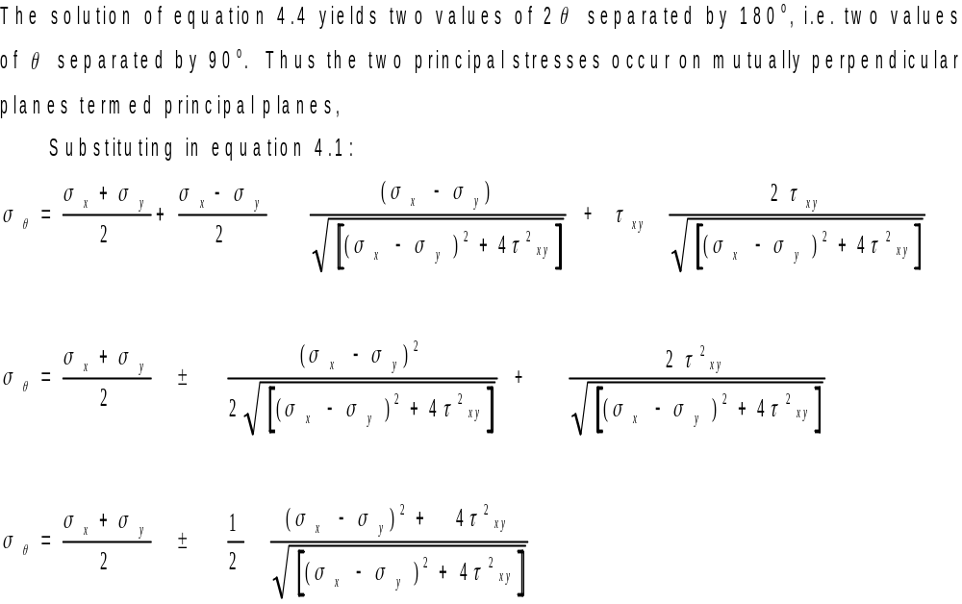
Principal Stresses and Maximum Shear Stresses Contd.

Slide 14
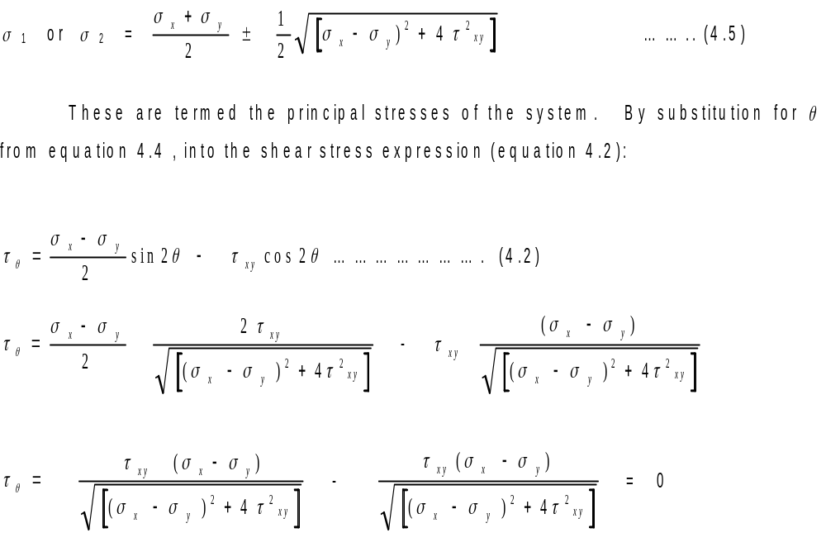
Shear Stresses at Principal Planes are Zero

Slide 15
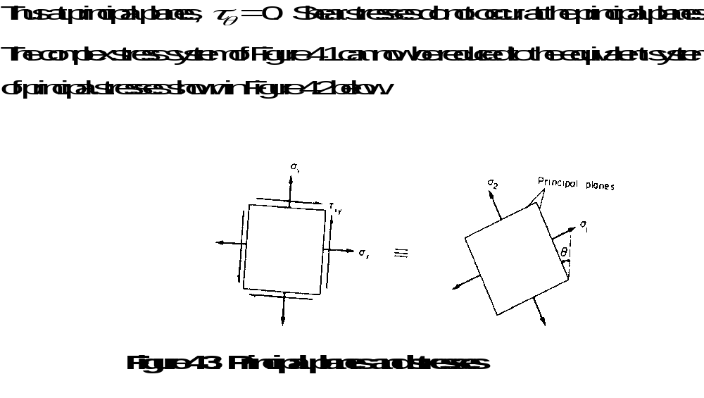
Principal Planes and Stresses Contd.

Slide 16
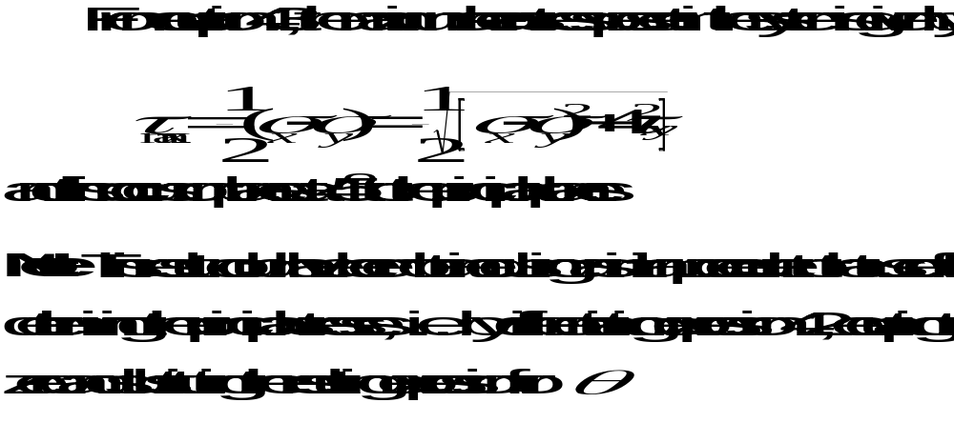
Equation For Maximum Shear Stress

Slide 17
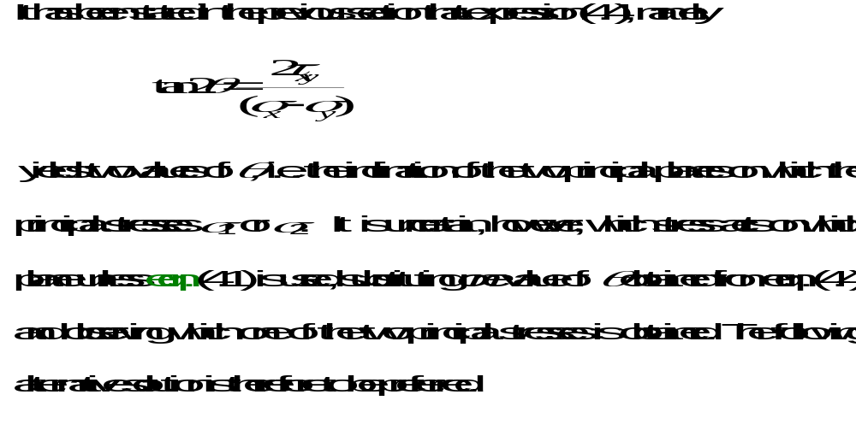
4.4 PRINCIPAL PLANE INCLINATION IN TERMS OF THE ASSOCIATED PRINCIPAL STRESS

Slide 18

PRINCIPAL PLANE INCLINATION CONTD.
Consider once again the equilibrium of a triangular block of material of unit depth (Fig. 4.3); this time EC is a principal plane on which a principal stress acts, and the shear stress is zero (from the property of principal planes).

Slide 19
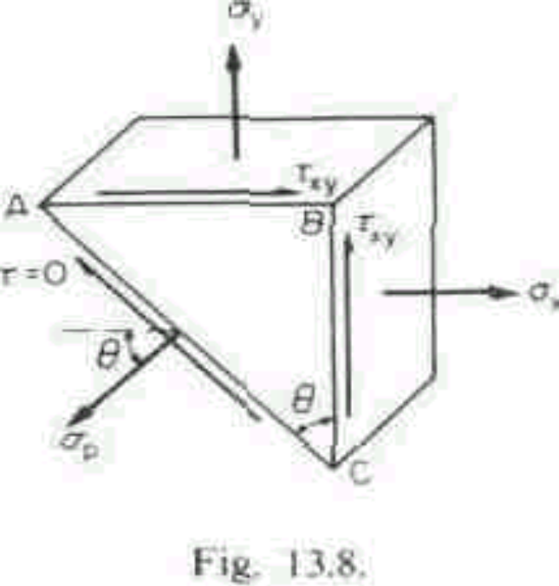
PRINCIPAL PLANE INCLINATION CONTD.
Resolving forces horizontally,
(
,
σ
x
BC
x
1) + (
τ
x
EB
x 1)
=
(
σ
x
EC x
l) cos
θ
x
xy
p
σ
EC
cos
θ
+
τ
x
EC sin
θ
=
σ
x
EC
cos
θ
x
xy
p
σ
+
τ
tan
θ
=
σ
x
xy
p
E
σ
−
σ
tan
θ
=
p
x
… (4.7)
τ
xy

Slide 20
PRINCIPAL PLANE INCLINATION CONTD.
Thus we have an equation for the inclination of the principal planes in terms of the principal stress. If, therefore, the principal stresses are determined and substituted in the above equation, each will give the corresponding angle of the plane on which it acts and there can then be no confusion.

Slide 21
PRINCIPAL PLANE INCLINATION CONTD.
The above formula has been derived with two tensile direct stresses and a shear stress system, as shown in the figure; should any of these be reversed in action, then the appropriate minus sign must be inserted in the equation.

Slide 22
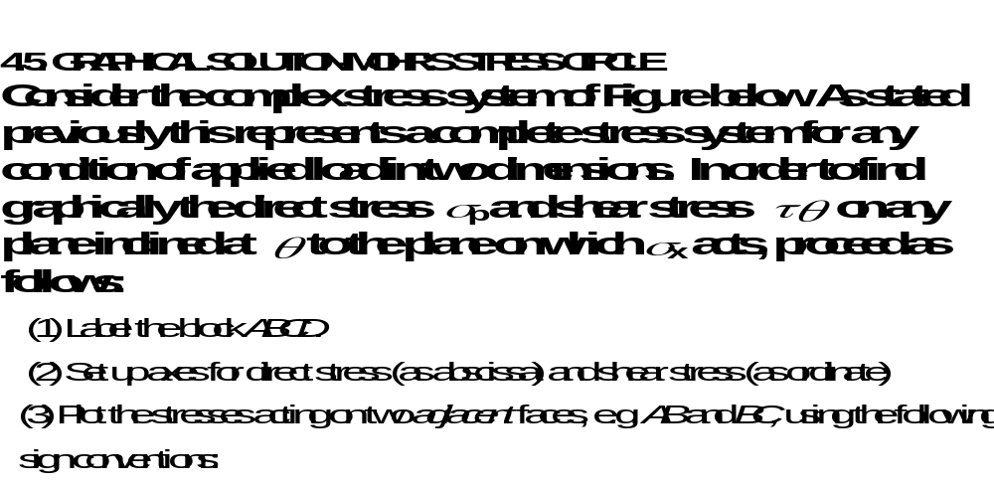
Graphical Solution Using the Mohr’s Stress Circle

Slide 23
Mohr’s Circle Contd.
Direct stresses: tensile, positive; compressive, negative;
Shear stresses: tending to turn block clockwise, positive; tending to turn block
counterclockwise, negative.
This gives two points on the graph which may then be labeled AB and BC respectively to denote stresses on these planes

Slide 24

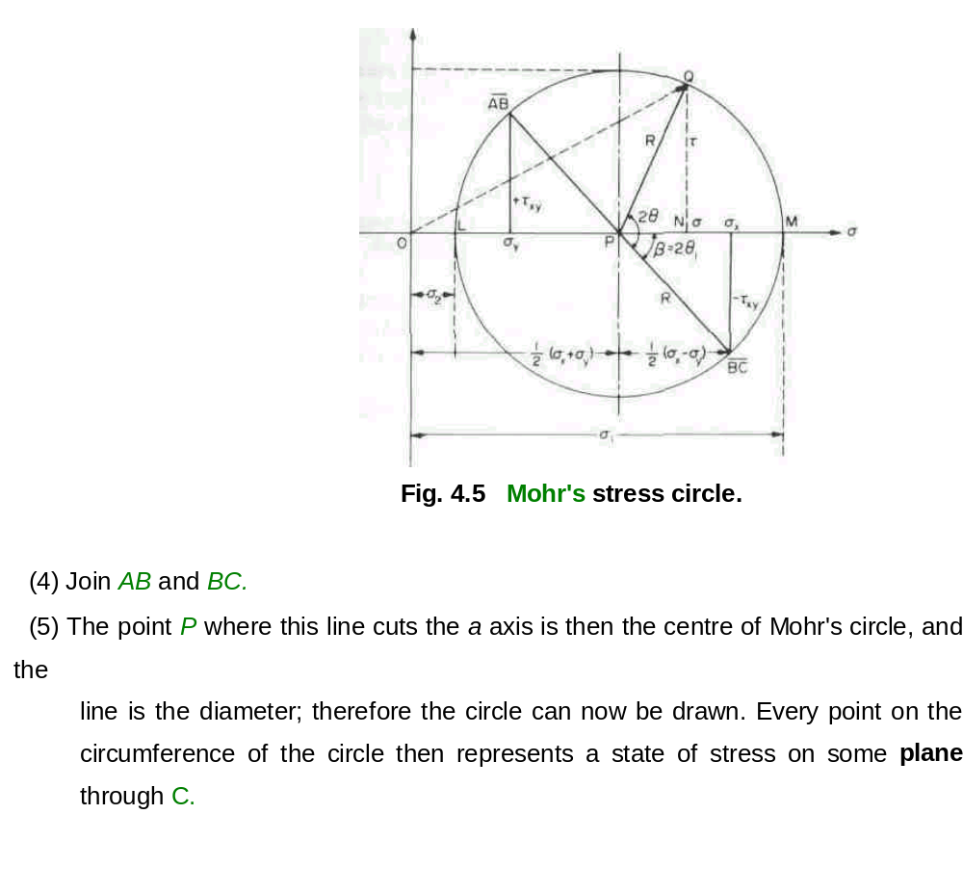



Mohr’s Circle Contd.
A
B
D
C

Slide 25
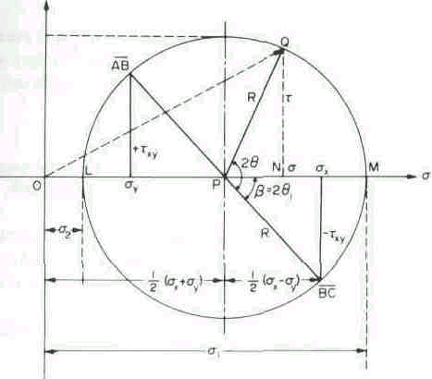
Fig. 4.5 Mohr's stress circle.

Slide 26
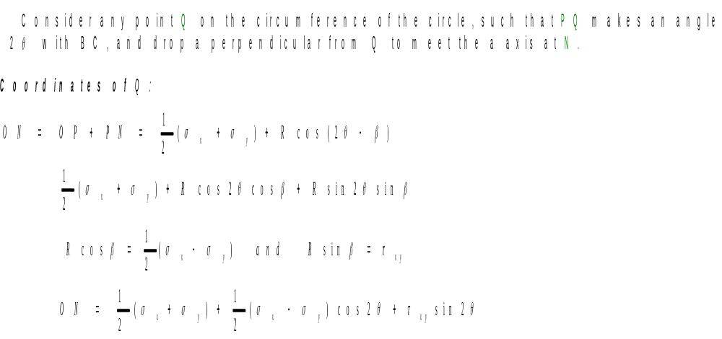
Proof

Slide 27
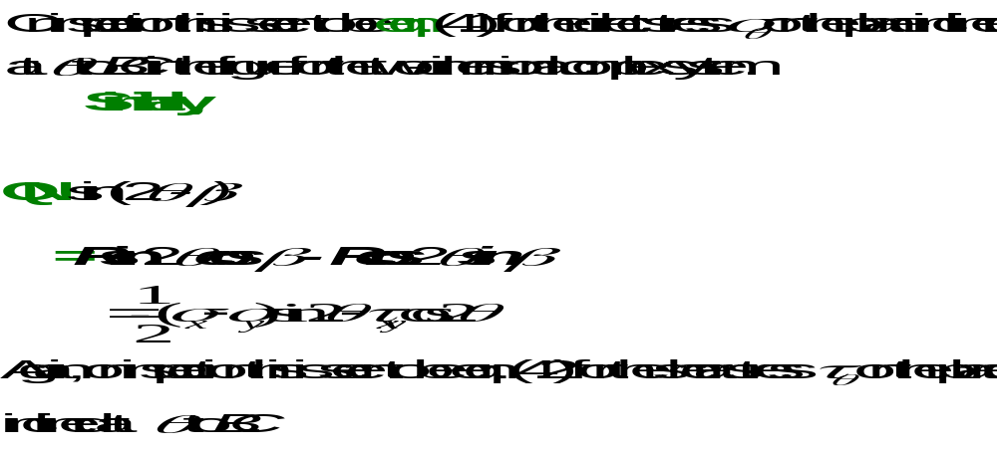
Proof Contd.

Slide 28
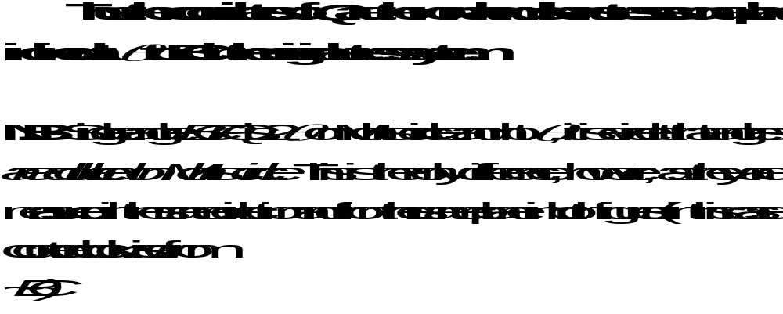
Note

Slide 29
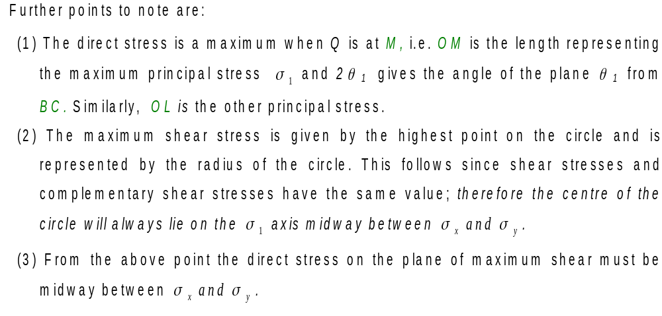
Further Notes on Mohr’s Circle

Slide 30
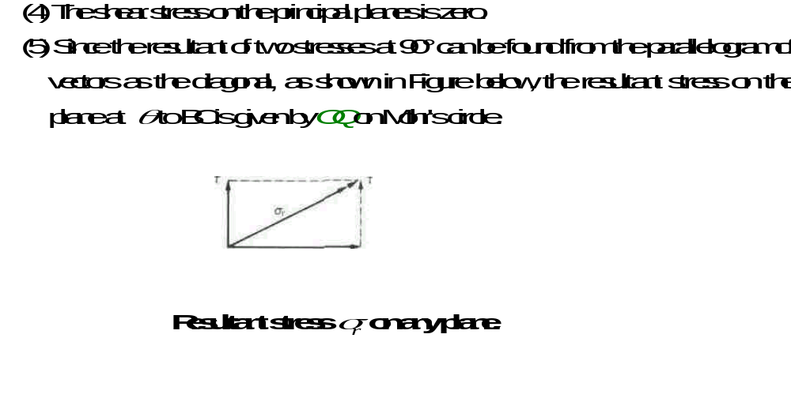
Further Notes on Mohr Circle Contd.

Slide 31
Preference of Mohr Circle
The graphical method of solution of complex stress problems using Mohr's circle is a very powerful technique since all the information relating to any plane within the stressed element is contained in the single construction.
It thus provides a convenient and rapid means of solution which is less prone to arithmetical errors and is highly recommended.

